Slide 1
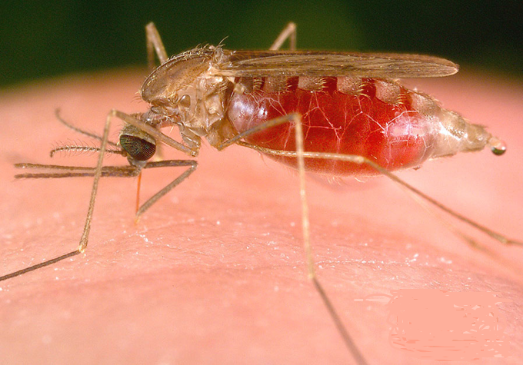
Capstone Project 2 Detection of Malaria Using Image Processing
About Malaria
Malaria is spread by the bite of the female Anopheles mosquito.
This species of mosquito is located world wide including in the United States.
The mosquito becomes infected with the Plasmodium parasite by feeding on the blood of an infected human.
The mosquito ingests the gametocytes (Sexually reproducing cells) of the parasite, which will take between 10-18 days to grow inside the mosquito.

Slide 2
Goal And Target Audience
Q. What is the problem you want to solve?
Goal of Project is detection of malaria cell-images using Deep Neural Network.
Q. Who is your client and why do they care about this problem?
It can be used by Medical Staff as Lab Technician or Help Doctors. And world care about this because……

Slide 3
Infection Rates
1,700 cases diagnosed in the United States each year
Primarily in return travelers and immigrant populations (“import” malaria)
212 million cases globally
429,000 deaths in 2015
In Africa, malaria costs around $12 billion a year in treatment, prevention, and premature death.

Slide 4
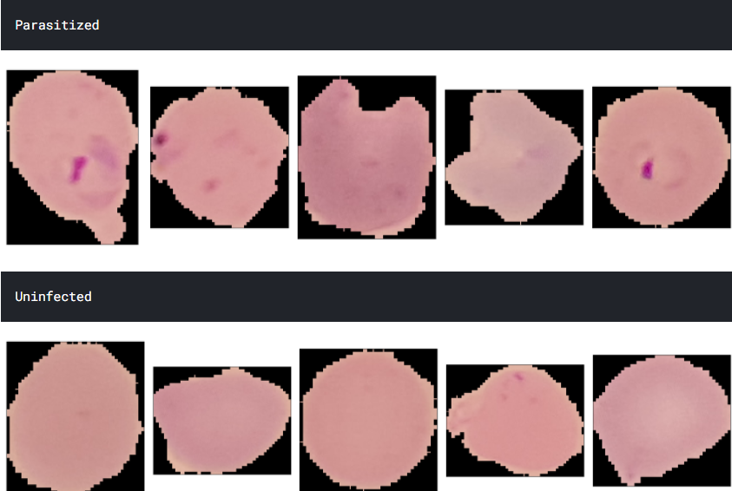
Blood Sample Images
Blood sample images of patients found malaria positive [ Parasitized ] and those are Uninfected

Slide 5
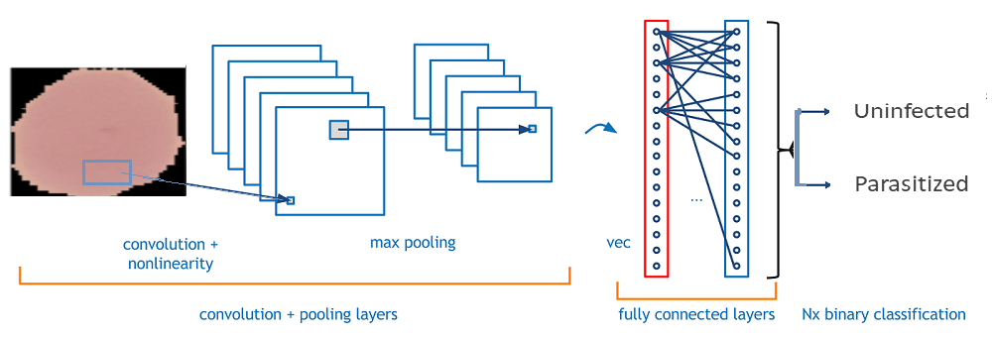
How Deep Learning and CNN works
Different Layers in Convolutional
Neural Network.
Input layer
Convo layer (Convo + ReLU)
Pooling layer
Fully connected(FC) layer
Softmax/logistic layer
Output layer

Slide 6
Approach and Solution
1. Data Exploration and Analysis
2. Preprocessing of the data.
3. Defining the Model.
4. Build the Model
5. Train the Model
6. Fit the model
7. Predict the test data and Calculate the Score , Accuracy
Step taken to solve the problems →

Slide 7
Data Exploration and Analysis
Data quality and common problems
Common data problems when training Object Detection models include:
Image dimensions and aspect ratios
Labels composition – imbalances, bounding box sizes, aspect ratios
Data preparation not suitable for your dataset.
This step includes exploring the images dataset and checks by raising questions like ,
Q. Is the dataset balanced for the each class?
Dataset contains two classes -
Number of Parasitized Images are = 13780
Number of Uninfected Images are = 13780
Q. Do we need more data to predict the problem?
Q. What is the size of the image in each class?
Hight
Width
Channels

Slide 8
Preprocessing of the data
To Feed the data to CNN network , Preprocessing is necessary.
[ Scaling , Normalization ]
Images are normally 2 dimensional with 1 or 3 color channels.
Preprocessing of images involve conversion of images into gray scale image. It will help to speed up the training process at least 3 times faster than 3 channel image.
[2 dimensional image with 1 channel is called Gray Scale]
Preprocessing also contain splitting the data into train and test set.

Slide 9
Build Train and Fit Model
Define the model that will take input as pre-processed data [ input layers ]
Add Convu Layers Pooling Layers & Fully connected Layers into the model.
Solve classification problem by adding Softmax Layers and generate output .
Use Train data to train and Fit model.

Slide 10
Results understanding
Prediction & Model Accuracy
Finally Predict the model on test data
Create Confusion Matrix , Classification Report .
Inspecting model results and performing error analysis can be a tricky process. Having one metric, rarely tells you the whole story and if you do have one interpreting it can be a relatively hard task.

Slide 11
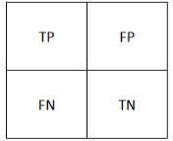
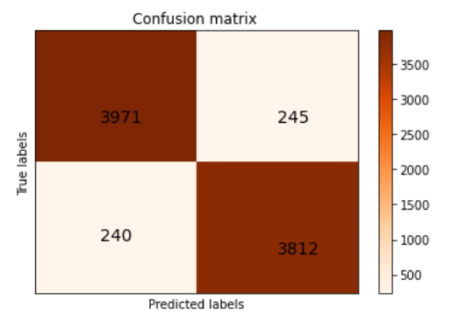
True Positive:
Interpretation: You predicted positive and it’s true.
You predicted that Parasitized Images – 3971 and it’s true
True Negative:
Interpretation: You predicted negative and it’s true.
You predicted that Uninfected Images – 3812 and it’s true
False Positive: (Type 1 Error)
Interpretation: You predicted positive and it’s false.
You predicted that Parasitized Images – 245 But they are Uninfected
False Negative: (Type 2 Error)
Interpretation: You predicted negative and it’s false.
You predicted that Uninfected Images – 240 But they are Parasitized

Slide 12
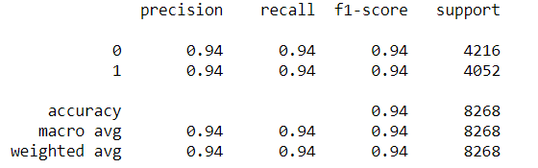
Classification Report .
Accuracy of the model is 0.94 %
F1-Score 0.94
Precision 0.94

Slide 13
Find Below More Info of Project
Below Contains the GitHub Links for Jupyter Notebooks and Python Code.
1. https://github.com/SANDIP79190219/Deep Learning/blob/main/Maleria_Deep_Learning_Grayscale.ipynb
2. https://github.com/SANDIP79190219/Deep-Learning/blob/main/Deep_Learning_Maleria.ipynb
Dataset Source - Malaria Cell Images Dataset | Kaggle

